Slide 1
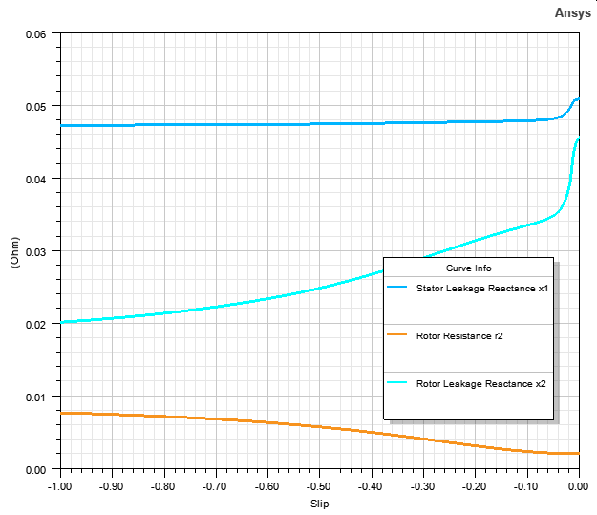
Rmxprt and equivalent circuit models Torque-Speed Characteristics

Slide 2
Rmxprt and equivalent circuit models Torque-Speed Characteristics

Slide 3
3-phase combined and 6-phase machines Torque-Speed Characteristics

Slide 5
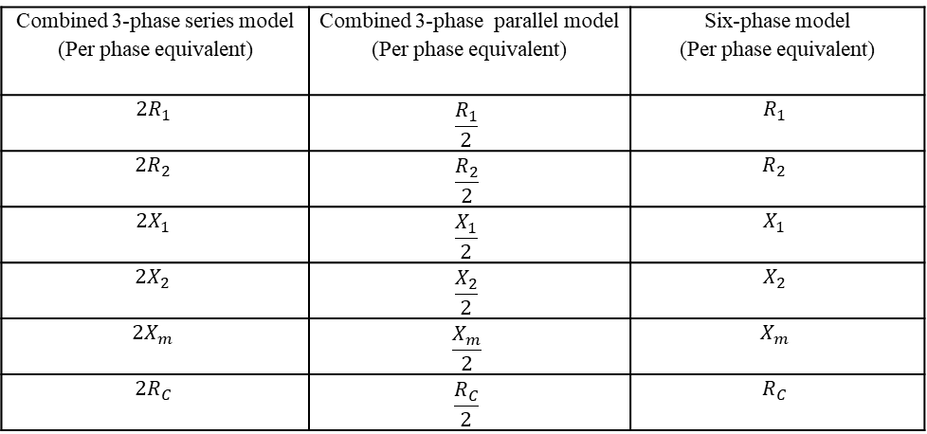
1 x 6-phase
2 x 3-phase
If there is no phase difference between the machines of ABC and XYZ, our circuit parameters change as given below.
Combined 3-phase series model (Per phase equivalent) | Combined 3-phase parallel model (Per phase equivalent) | Six-phase model (Per phase equivalent)
$${2R}_{1}$$ | $$\frac{R_{1}}{2}$$ | $$R_{1}$$
$${2R}_{2}$$ | $$\frac{R_{2}}{2}$$ | $$R_{2}$$
$${2X}_{1}$$ | $$\frac{X_{1}}{2}$$ | $$X_{1}$$
$${2X}_{2}$$ | $$\frac{X_{2}}{2}$$ | $$X_{2}$$
$${2X}_{m}$$ | $$\frac{X_{m}}{2}$$ | $$X_{m}$$
$${2R}_{C}$$ | $$\frac{R_{C}}{2}$$ | $$R_{C}$$

Slide 6
1 x 3-phase parallel
2 x 3-phase

Slide 7
1 x 3-phase series
2 x 3-phase

Slide 8
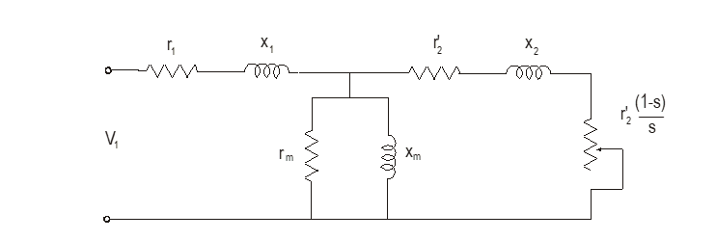
We have actually 30-deree phase difference at the induced voltage. It means that actually distribution factor should become involved.
Where,
r₁ = stator winding resistance
x₁ = stator winding leakage reactance
r_{c} = resistance-representing core losses
x_{m}= magnetising reactance
r₂'= rotor winding resistance referred to the primary
x₂'= rotor winding reactance referred to the primary

Slide 9
We have actually 30-deree phase difference at the induced voltage. It means that actually distribution factor should become involved.
Where,
r₁ = stator winding resistance
x₁ = stator winding leakage reactance
r_{c} = resistance-representing core losses
x_{m}= magnetising reactance
r₂'= rotor winding resistance referred to the primary
x₂'= rotor winding reactance referred to the primary

Slide 10
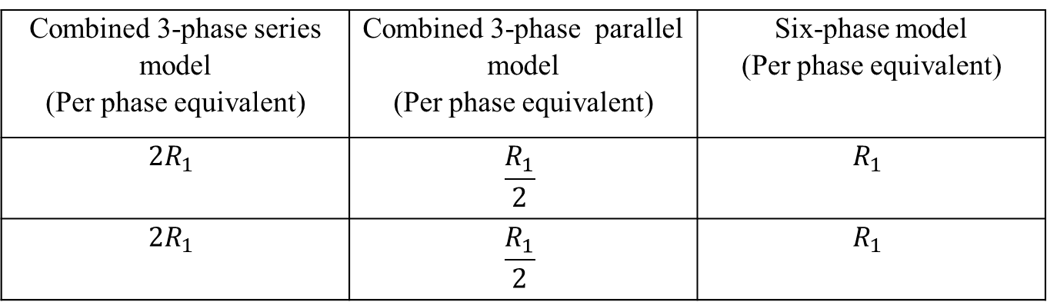

Resistance Calculation in Induction Motor
$R=L\frac{ρ}{A}$
Combined 3-phase series model (Per phase equivalent) | Combined 3-phase parallel model (Per phase equivalent) | Six-phase model (Per phase equivalent)
$${2R}_{1}$$ | $$\frac{R_{1}}{2}$$ | $$R_{1}$$
$${2R}_{1}$$ | $$\frac{R_{1}}{2}$$ | $$R_{1}$$

Slide 11
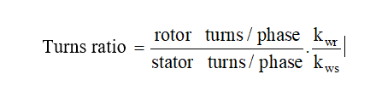
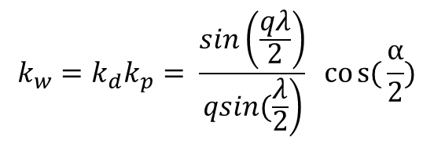
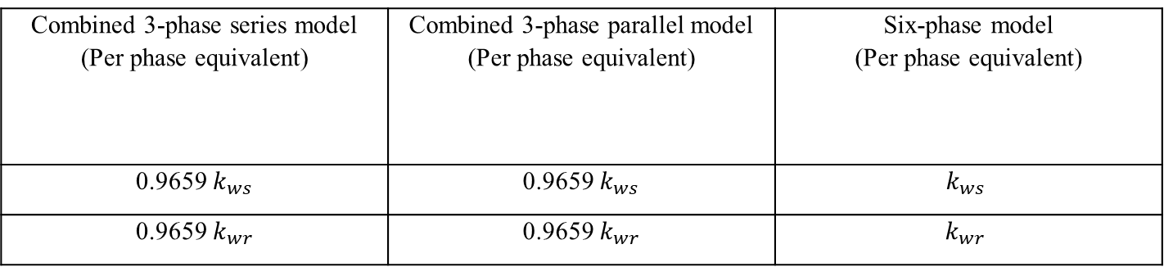
Stator Rotor Turns Ratio
$$k_{w}=k_{d}k_{p}= \frac{sin\left(\frac{qλ}{2}\right)}{\left.qsin(\frac{λ}{2}\right)} cos{(}\frac{α}{2})$$
Combined 3-phase series model (Per phase equivalent) | Combined 3-phase parallel model (Per phase equivalent) | Six-phase model (Per phase equivalent)
0.9659 $k_{ws}$ | 0.9659 $k_{ws}$ | $$k_{ws}$$
0.9659 $k_{wr}$ | 0.9659 $k_{wr}$ | $$k_{wr}$$

Slide 12
Stator Rotor Turns Ratio
$$k_{w}=k_{d}k_{p}= \frac{sin\left(\frac{qλ}{2}\right)}{\left.qsin(\frac{λ}{2}\right)} cos{(}\frac{α}{2})$$
Combined 3-phase series model (Per phase equivalent) | Combined 3-phase parallel model (Per phase equivalent) | Six-phase model (Per phase equivalent)
0.9659 $k_{ws}$ | 0.9659 $k_{ws}$ | $$k_{ws}$$
0.9659 $k_{wr}$ | 0.9659 $k_{wr}$ | $$k_{wr}$$

Slide 13
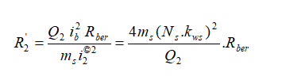
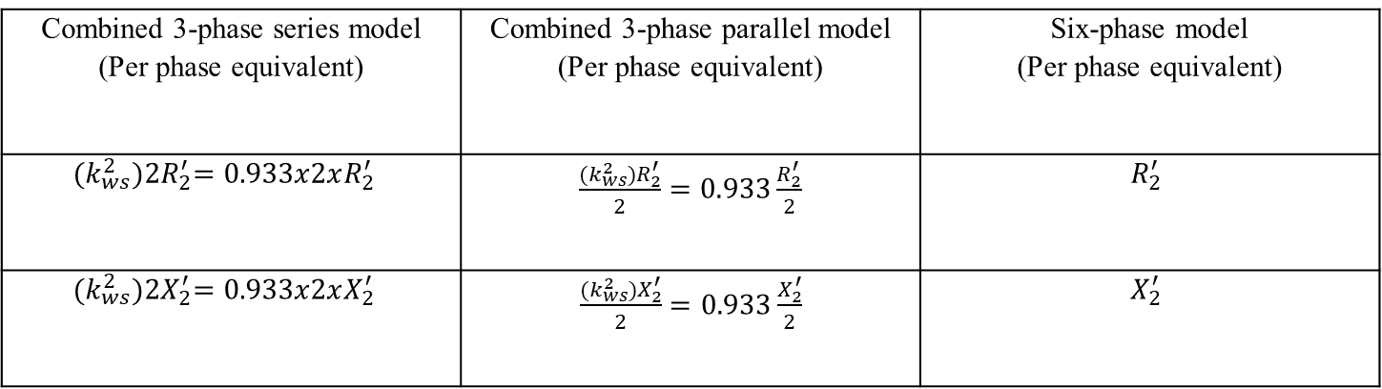
Cage Rotor Parameters
Combined 3-phase series model (Per phase equivalent) | Combined 3-phase parallel model (Per phase equivalent) | Six-phase model (Per phase equivalent)
$${(k_{ws}^{2})2R}_{2}^{′}=0.933x2xR_{2}^{′}$$ | $\frac{{(k_{ws}^{2})R}_{2}^{′}}{2}=0.933\frac{R_{2}^{′}}{2}$ | $$R_{2}^{′}$$
$${(k_{ws}^{2})2X}_{2}^{′}=0.933x2xX_{2}^{′}$$ | $\frac{{(k_{ws}^{2})X}_{2}^{′}}{2}=0.933\frac{X_{2}^{′}}{2}$ | $$X_{2}^{′}$$

Slide 14

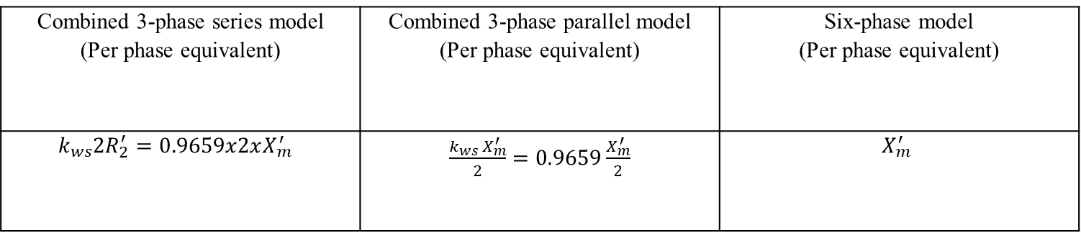
Magnetizing Reactance
Combined 3-phase series model (Per phase equivalent) | Combined 3-phase parallel model (Per phase equivalent) | Six-phase model (Per phase equivalent)
$${k_{ws}2R}_{2}^{′}=0.9659x2xX_{m}^{′}$$ | $\frac{{k_{ws} X}_{m}^{′}}{2}=0.9659\frac{X_{m}^{′}}{2}$ | $$X_{m}^{′}$$

